Slide 1
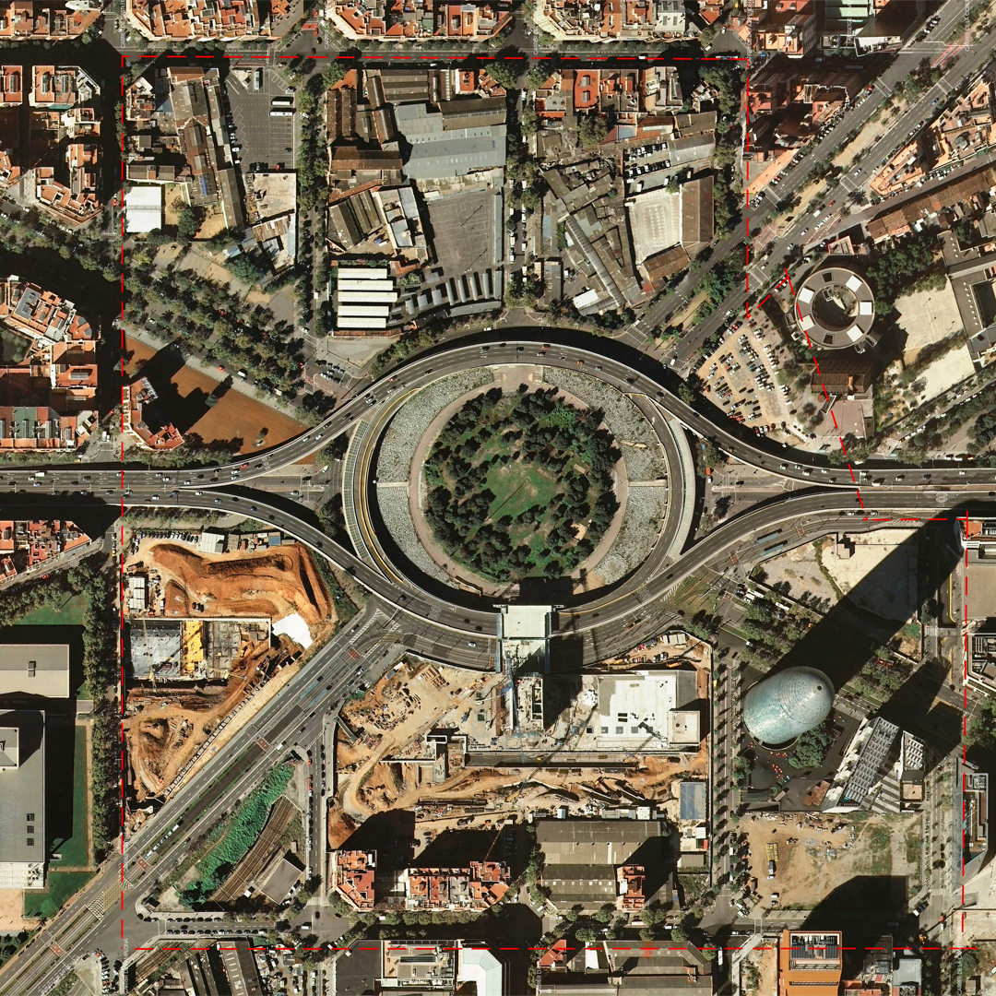
Barcelona Road traffic accidents: what happens in august
Sabbah & Elliott

Slide 2
Project goals
Our playlist…
‘Here comes the summer sun’
‘It’s a long days night’
‘Working 9 to 5’
Skills used…
Locate
Understand
Pandas, SQL
Interrogate
Report

Slide 3
Data source
Who, why?
Open Data BCN
“Hem après algun català”
Where, what, when?
Repeating identifiers, UTF8, trailing white space

Slide 4
Findings
Time (Hrs)
0 165
1 121
2 85
3 73
4 66
5 77
6 195
7 313
8 546
9 572
10 511
11 575
Time (Hrs)
12 535
13 677
14 704
15 615
16 625
17 622
18 659
19 605
20 579
21 427
22 352
23 231
Influence of month
10 - Oct 989
5 - May 874
7 - July 864
3 - Mar 862
4 - Apr 853
1 - Jan 851
6 - Jun 828
11 - Nov 805
12 - Dec 800
2 - Feb 770
9 - Sep 751
8 - Aug 683
Influence time of day

Slide 5
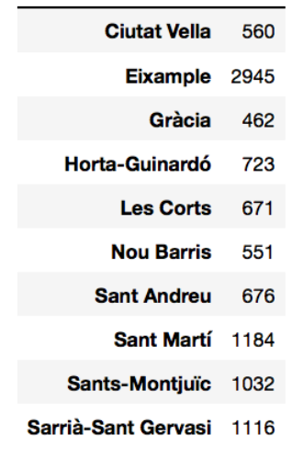
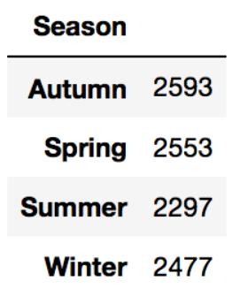
Findings
Influence of SEASONS
District

Slide 6
Learning & Further research
We’re smart…
Clean data in Pandas
Create AWS DB
Panda -> SQL
Created relational DB
But could be smarter…
Look at multiple years
Overlay different data sets

Slide 7
Thank you!

